Slide 1
NIEM 300
IEPD Discovery and Development
Presenter Name
Organization
Date
TRAINING

Slide 2
Course Objectives
Welcome to NIEM 300: IEPD Discovery and Development
This course is designed to equip you with the skills necessary to plan for, analyze, and begin to build NIEM-conformant Exchanges, also referred to as Information Exchange Package Documentations (IEPDs).
By the end of this course, you’ll be able to:
Perform the necessary research to begin to develop an IEPD
Develop a Use Case, Sequence Diagram, Business Process Diagram and an Exchange Content Model to define the business and technical structure of the information exchange
Define the Business Scenario, Rules, and Requirements necessary for IEPD development
DURATION
4 Hour
PREREQUISITES
NIEM 100: NIEM General Overview
NIEM 101: Technical Introduction to NIEM
Participants should have a basic knowledge of modeling business processes, and it is requested that participants bring a laptop to more effectively participate in course exercises.

Slide 3
Agenda
Concept Refresh
Scenario Planning
Analyze Requirements
Map and Model
Conclusion

Slide 4
Concept Refresh
Course Progress
0% complete

Slide 5
Learning Objectives
Welcome to Module 1: Concept Refresh
At the end of this module, you’ll be able to:
Define NIEM and how it works
Define an IEPD
Identify some of the benefits of NIEM
Summarize each phase of the NIEM Information Exchange (IEPD) Development Lifecycle

Slide 6
NIEM Overview
NIEM is a community-driven, government-wide, standards-based approach to exchanging information. Diverse communities can collectively leverage NIEM to increase efficiencies and improve decision-making.
It is available to everyone, including both public and private organizations. NIEM includes a data model, governance, training, tools, technical support services, and an active community to assist users in adopting a standards-based approach to exchanging data.
Community
Technical Framework
Support Framework
Formal Governance Processes
Data Model
Tools for Development and Discovery
Online Repositories
XML Design Rules
Established Training Program
Mission-Oriented Domains
Development Methodology
Implementation Support
Self-Managing Domain Stewards
Predefined Deliverables (IEPD)
Help Desk & Knowledge Center

Slide 7
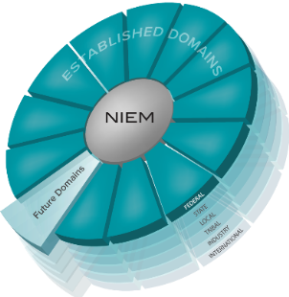
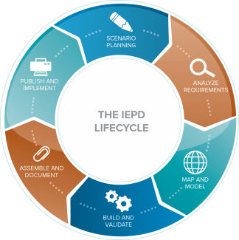
How NIEM Works
Common Language (Community-driven Data Model)
Repeatable, Reusable Process
(Information Exchange Development Lifecycle)
Built and governed by the business users at Federal, State, Local, Tribal, International and Private Sectors

Slide 8
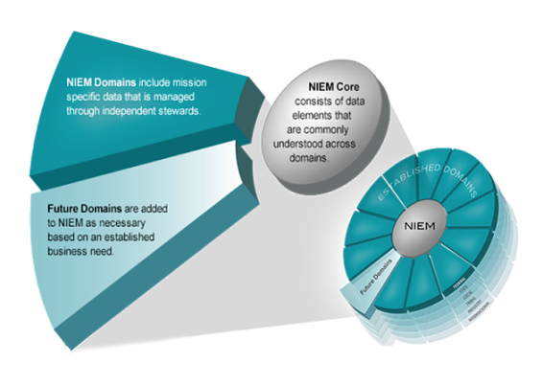
Model Overview
Words are to a dictionary as elements are to a data model.
Think of the NIEM data model as a mature and stable data dictionary of agreed-upon terms, definitions, and formats independent of how information is stored in individual agency systems.
The data model consists of two sets of closely related vocabularies: NIEM Core and individual NIEM Domains.

Slide 9
NIEM provides…
Collaboration
Consistency
Development
Support
Brings stakeholders together through reuse and community engagement
Provides a standardized framework and mature governance
Supplies tools to aid in discovery and creation of exchanges
Provides technical assistance and training
Which Lead To
Lower Development Costs
Enhanced Mission Capabilities
Common Vocabulary
Reduced Maintenance Costs

Slide 10
What is a niem exchange?
An Information Exchange Package Documentation (IEPD) is a collection of artifacts that describe the construction and content of an information exchange
Core Functions of an IEPD:
Developed to provide the business, functional, and technical details of the information exchange through predefined artifacts
Created with a core set of artifacts in a prescribed format and organizational structure to allow for consistency
Designed to be shared and reused in the development of new information exchanges through the publication in IEPD repositories

Slide 11
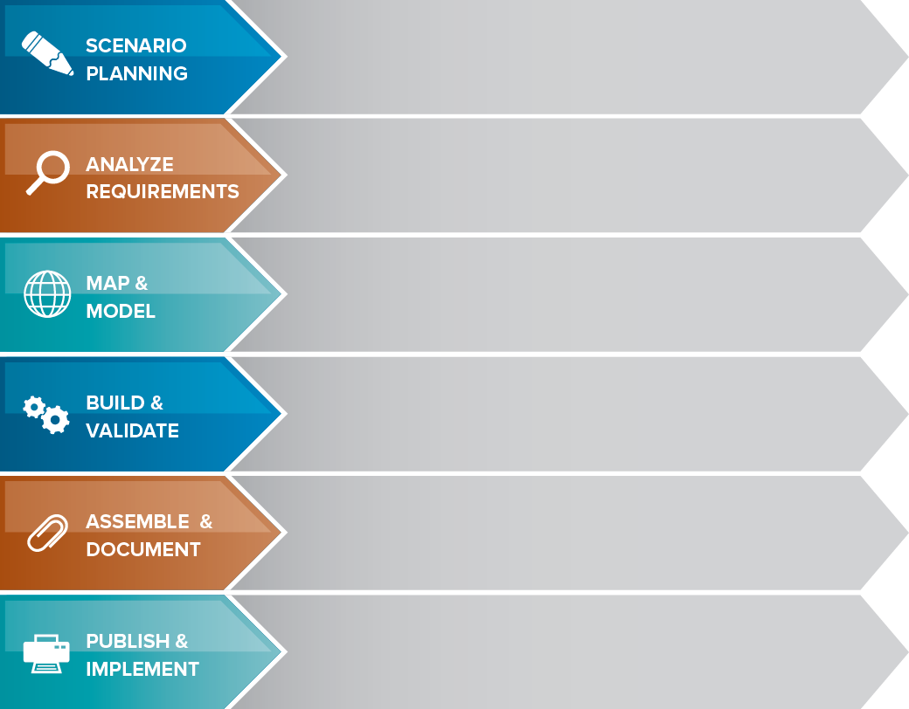
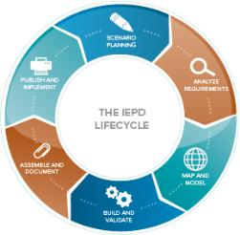
IEPD Lifecycle Recap
Review background, assess resource impact, understand business context, and identify information exchange business scenarios
Selected information exchange scenario is further elaborated to understand and document the business context and data requirements
Create an exchange content model based on information exchange requirements. The Exchange Content Model is then mapped to NIEM.
Create a set of exchange-specific NIEM conformant XML Schemas that implement the data model created for the exchange
Prepare and package all related files for this IEPD into a single self‐contained, self-documented, portable archive file
Implement the IEPD into production as well as publish the IEPD for search, discovery, and reuse.

Slide 12
The IEPD Artifacts
Business Process Diagrams
Use Case Diagrams
Sequence Diagrams
IEPDs contain both required and recommended artifacts
Required:
Bold and Blue
Recommended:
Plain
Note:
Best practices for most organizations include many of the artifacts listed here.
Please review Model Package Description (MPD) Specification for more information
Business Rules
Business Requirements
Exchange Content Model
Mapping Document
Subset Schema
Exchange Schema
Wantlist
Constraint Schema
Extension Schema
Reference Schema
XML Stylesheets
Master Document
Catalog
Change Log
Sample XML Instances
No required artifacts. Publish the IEPD to a repository and implement the exchange

Slide 13
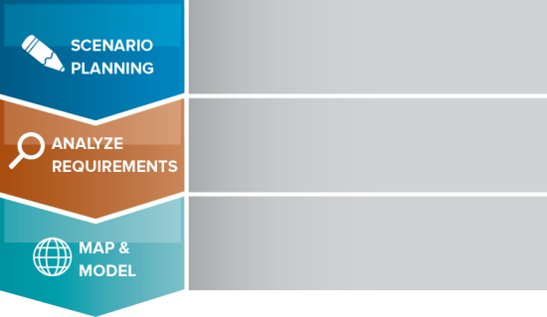
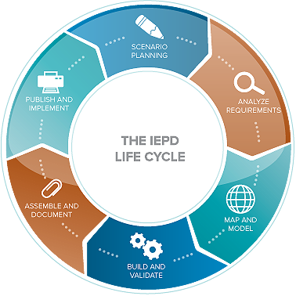
Tasks within IEPD Development
IEPD Lifecycle
Discover Existing IEPDs
Review Documents
Conduct Stakeholder Interviews
Assess Resource Impacts
Create Business Scenarios
Business Rules
Business Requirements
Create Exchange Content Model

Slide 14
Module 1: summary
You have completed Module 1: Concept Refresh
You should now be able to:
Define NIEM and how it works
Define an IEPD
Identify some of the benefits of NIEM
Summarize each phase of the NIEM Information Exchange (IEPD) Development Lifecycle

Slide 15
Scenario Planning
Course Progress
20% complete

Slide 16
Learning Objectives
Welcome to Module 2: Scenario Planning
At the end of this module, you’ll be able to:
Explain the benefits of aligning existing exchanges to NIEM
Identify the elements of a Use Case diagram
Describe the elements in a Business Process diagram
Explain how to develop a Sequence diagram

Slide 17
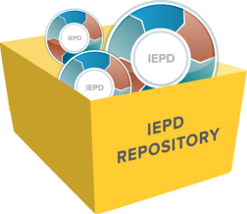
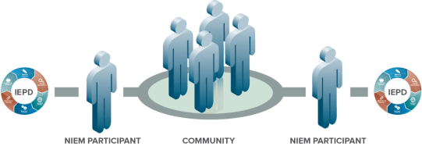
Discover Existing IEPDs
The first step in developing information exchanges is to identify existing exchanges, which may be similar to the information exchange being developed. To identify existing exchanges, practitioners should search online IEPD repositories or leverage the NIEM community.
Repositories
Community

Slide 18
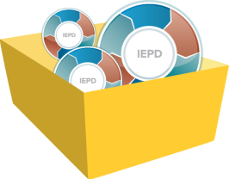
IEPD Repositories
IEPD Repositories are online systems used to store IEPDs and enable search, discovery, and reuse of IEPDs
Publish an IEPD to all repositories that are relevant to the exchange; the more exposure the better
If an organization is developing a significant number of IEPDs, the development of a “local” repository may add significant value
Repositories do not have to be limited to IEPDs; other systems integration artifacts can be included if relevant to the exchange
If the IEPD is being developed based on a Grant, the publication to a repository may be a REQUIRED step
Available IEPD Repositories:
Your Organization’s Internal Exchange Repository
IEPD Clearinghouse

Slide 19
IEPD Reuse Through Community
Leveraging the NIEM community, not just repositories, is a valuable tool
Fellow Practitioners
Individuals with NIEM subject matter expertise can provide IEPD best practices and advice.
NIEM User Groups
Groups of NIEM practitioners with similar interests exist which help in the IEPD discovery process.
Help Desk
The Help Desk can help users locate IEPDs and answer other questions related to NIEM.
Use these resources to build an information exchange “network” to assist in the development process

Slide 20

Existing Exchanges and NIEM
Not every legacy exchange will be a candidate for conversion to a NIEM based exchange.
The following exchanges are some examples of candidates for aligning to NIEM:
Exchanges where new exchange partners might benefit from using NIEM
Exchanges that use another standard that might have synergies with NIEM
Exchanges that are frequently reused within or outside an organization
Why align existing exchanges to NIEM?
Provides business agility through interoperability
Enables more efficient future reuse of data objects which leads to cost reduction
Improves consistency and minimizes redundancy in definition of data objects

Slide 21
Review Documentation
Analysis of existing documentation should be conducted to determine:
Current technical architecture documents of all exchange partners
Stakeholders that will be involved in the exchange
Security, privacy, and other policy-related concerns associated with the exchange
Technical characteristics of the exchange:
Types of data being shared
Number of data objects
Current structure of the data (logical, physical)
Use of external standards
Documentation provides valuable information about an exchange. Stakeholder interviews may be able to fill those gaps.

Slide 22
Conduct Stakeholder Interviews
Stakeholder interviews are conducted to provide an understanding of the information exchange environment. Interview results will enable an organization to more effectively exchange information between stakeholders.
Identify the Stakeholders
Organization(s) with whom you are exchanging information
NIEM community stakeholders in the same mission space for initial exchange guidance
NIEM practitioners from your organization
Potential interview outcomes
Understand exchange requirements and expectations
Identify data objects in the NIEM data model and/or existing IEPDs that can be reused in the exchange
Learn best practices for NIEM alignment and IEPD development

Slide 23
Assess Resource Impacts
Differences in exchange complexity will have an effect on the resources required to develop the IEPD and will assist in determining which IEPD artifacts should be developed as part of the exchange.
Low Resource Impacts
Existing exchange
Information is already available about service/exchange (well documented)
Relatively simple exchange content model (minimal number of data objects, well-structured)
NIEM conformant external standards are already in use
High Resource Impacts
New exchange
Minimal documentation available about service or exchange (poorly documented)
Relatively complex exchange content model (large number of data objects, not well-structured)
All stakeholders associated with this exchange should be involved in determining the complexity so that all factors are understood and taken into account when planning the exchange.

Slide 24
Modeling Business Scenarios
An effective business scenario is: Informative, strategic, and comprehensive
Modeling creates a graphical representation of information exchange requirements and is essential in assisting the user to depict the scenario that will ultimately drive the building of the information exchange
Using diagrams when creating business scenarios is an effective first step for accomplishing this
The following diagrams assist with IEPD development by providing business context and details around each information exchange and where it fits into a larger overall process.
These diagrams should be included in an IEPD:
Use Case Diagrams
Business Process Diagrams
Sequence Diagrams
Used to describe
Functionality
Used to describe
Activity Sequencing
Used to describe
Message Flow

Slide 25
What is a Use Case Diagram?
A Use Case is a graphical representation of the functionality of a particular information exchange as perceived by an external observer
Depicts system interactions; a role that a human, device, or system “plays” within the diagram
ACTOR
Depicts system functionality such as main or sub functionality, a user goal, or an activity system
USE CASE
Depicts the relationships actors have with use cases and each other
Relationship
Contains all functionality and limits scope of the diagram
SYSTEM

Slide 26
A Use Case Diagram Example
Actor 1
Traveler Processing System
Review
Result
Leave Customs Station
Review
Documents
Submit
Documents
Use Case
Review Query Results
Traveler
Display Query Results
Airport Officer
Permission,
Granted
or
Denied!
Submit Query
Make Travel
Decision
Actor 2
Display
Result
Start Person
Query Message
Process Query Message
Return Query Results
Airport Screening Application
Create Traveler History Message
Send Traveler
History Message
Save Traveler History
Customs
Application

Slide 27
What is a Business Process Diagram?
A graphical and sequential representation of the activities involved in an exchange; similar to a workflow diagram
Any person, organization, or system directly or indirectly involved in the information exchange
STAKEHOLDER
Correlates the data being exchanged with any activity that drives it
ACTIVITY
GATEWAY—
EVENT BASED
Activities that force a decision upon a stakeholder
Connects business processes and events to show the direction of activities in the diagram
FLOW
START EVENT
STOP EVENT
Acts as an activity trigger or represents the result or completion of an activity

Slide 28
Steps in developing a scenario
To create a scenario using a Business Process Diagram, follow these recommended steps:
1. Determine the number of actors involved in the process for the information exchange by analyzing the scenario and identifying them.
2. Create a box that will serve as the frame containing your Business Process Diagram.
3. Divide the box into “swim lanes” for each of the actors in the process.
Activity
Activity
Activity
4. Draw a line dividing the header section to indicate each actor from the section that will contain the actor’s activities.
5. Insert each of the actors into the header section so that they have their own “swim lane” in the diagram.
Activity
Activity
Activity
6. Create a starting node on the diagram in the far left of the swim lane for the actor that initiates the process for the information exchange.
7. Fill in the Business Process Diagram from left to right, beginning after the starting node, with each of the activities or events, in chronological order, involved in the information exchange. Also make sure to insert a terminal node that indicates the end of the process.
Activity
Activity
8. Fill in the arrows that connect each of the activities in the diagram
9. Review your Business Process Diagram to ensure that it matches the process described in the scenario.

Slide 29
Business Process Diagram Example
Business Process Diagram Example
Traveler
Submit Documents
Leave Customs Screening Station
Start
Yes
Airport
Officer
Review & Submit Query
Review Person Query Results
No
Perform Investigation
Release traveler?
Stop
Airport Screening
Application
Execute Person Query Message
Display Person Query Results
Create & Send Person History Travel Message
Customs Application
Process Person Query Message
Return Person Query Results
Save Traveler HIstory
Stop

Slide 30
What is a Sequence Diagram?
A Sequence Diagram is an interaction diagram that shows how applications or systems operate with one another. It displays the sequential order of operational processes or messages between applications as horizontal arrows between the parallel, vertical lines that are used for applications. This allows the specification of simple runtime scenarios in a graphical manner.
A typical Sequence Diagram should include each of the following elements:
APPLICATIONS
Any application involved in sending messages within the information exchange
Any message being sent between applications within the information exchange
MESSAGES

Slide 31
Sequence Diagram Example
This sub-process of the airport screening has three interacting applications: the Airport Screening Application, the Customs Application, and the Airport Travel History Application.
Airport Screening Application
Customs
Application
Airport History Application
sendPersonQuery(person)
returnPersonResults(person)
sendPersonHistoryTravelQuery(person)
returnPersonHistoryTravelResults(person, history)

Slide 32
Module 2: Knowledge check 2
Which of the following can be created to ensure an operational “picture” of the information exchange is documented?
A. Use Case Scenario
B. Business Process Diagram
C. Sequence Diagram
D. All of the above

Slide 33
Module 2: Knowledge check 3
Identify the actors in the following Business Process Diagram.
Business Process Diagram Example
Traveler
Submit Documents
Leave Customs Screening Area
START
Yes
Airport Officer
Review & Submit Query
Review Person Query Results
Release Traveler?
No
Perform Investigation
END
Airport Screening
Application
Execute Person Query Message
Display Person Query Results
Create & Send Person History Travel Message
Customs Application
Process Person Query Message
Return Person Query Results
Save Traveler HIstory
END

Slide 34
summary
You have completed Module 2: Scenario Planning
You should now be able to:
Explain the benefits of aligning existing exchanges to NIEM
Identify the elements of a Use Case diagram
Describe the elements in a Business Process diagram
Explain how to develop a Sequence diagram

Slide 35
Analyze Requirements
Course Progress
40% complete

Slide 36
Learning Objectives
Welcome to Module 3: Analyze Requirements
At the end of this module, you’ll be able to:
Develop Business Rules and Business Requirements

Slide 37
Business Needs
Business Rules and Business Requirements define the exchange as well as the expectations of the exchange.
Business Rules
A specific qualification for data that refers to how it should be structured (field length, constraints, etc.)
Business Requirements
A business driver for an information exchange that is primarily an operational or functional requirement
EX: If a student’s enrollment status is not available or is unknown, it is assumed they are not enrolled and an information-needed flag will be added by setting X element to the value of 1.
EX: The Verification Service shall respond only to search requests issued by the client application, the Verification Information System (VIS).

Slide 38
Developing Business Requirements
Follow a formal process to define and validate business requirements and accurately document an information exchange:
Initiate the Requirements Process
Define the Exchange Requirements
Prepare Requirements for Design
Prepare and Plan
Perform Analysis
Gather User Requirements
Define Security & Privacy Requirements
Specify Exchange Requirements
Analyze Requirements
Verify & Validate Requirements
Note: Not all requirements for an exchange are applicable to an IEPD. Some requirements are related to implementation and fall out of the scope of NIEM and IEPDs.

Slide 39
Exercise: Create Effective Requirements
Following an effective method for creating requirements can lead to more precise business requirements.
Using the business case on the next slide, think about and create three effective business requirements then share with other project managers to validate.
Objective
Exercise
Create business requirements for an example exchange
Business requirements will be created by participants and then evaluated

Slide 40
Exercise: Create Effective Requirements
Business Case
A large, urban city identified the need to create a series of exchanges that would allow parents, city-wide, to apply online for their children’s school meals program and automate the processing of the request between the Human Services Agency and the school.
This will be implemented via a web-based service that, upon submission, will automatically check the city’s Human Services agency database to ensure the applicant is from a low-income family and qualifies for the school meals program. If qualified, the web-based service will then notify the respective school to add the child to the meal program.
Currently, the only means the city has to process school meal program applications is through paper-based applications at the city Human Services Agency office. Once approved, the Human Services Agency faxes approved applications to the particular school where the child attends. Overall, it is a manual process that inhibits timely delivery of citizen services.

Slide 41
Solution: Create Effective Requirements
Results will vary between individuals. Examples of good requirements include:
Candidate Message Exchange Packages
Request from Parent to Human Services Agency for meal program
Eligibility request from Human Services Agency web-based service to eligibility system
Eligibility reply from Human Services Agency to parent
Notification to add child to meal program from Human Services Agency to school
Request from school to Human Services Agency for monthly report
Monthly report reply from Human Services Agency to school
Performance Requirements
The web-based service will notify parents via email whether or not their child qualifies for the school meals program ten minutes after receiving their application.
A school will receive notification within 24 hours of a new qualified child within their school.
Reporting Requirements
Each school in the city shall be able to receive a monthly report of every child in their school who is currently enrolled in the school meals program.
Data Quality Requirements should be taken into consideration once above requirements are discussed.

Slide 42
Summary
You have completed Module 3: Analyze Requirements
You should now be able to:
Develop Business Rules and Business Requirements

Slide 43
Map & Model
Course Progress
60% complete

Slide 44
Learning Objectives
Welcome to Module 4: Map & Model
At the end of this module, you’ll be able to:
Build an exchange content model

Slide 45
Exchange Content Model Overview
Exchange content models model the content and structure of the data being exchanged. Most common methodology is based on Unified Modeling Language (UML) Class Diagrams, which consist of:
Objects
Elements
Construct that represents a person, place, thing, etc.
Structured and able to contain instances of itself
Specification that defines a property of an object
Defines the unique characteristics of an object
Associations
Interactions between objects that portray structure
Defines the relationships between data
Cardinality
Defines numeric relationships between objects, elements, and associations

Slide 46
Content Modeling: Object
Definition
Implementation
Something that represents a physical or conceptual thing; person, place, location, idea, etc.
Contains an object name and may contain elements
Can be simple or complex, with hierarchal associations between them
Typically represents XML elements
Representation
ObjectName
Element: Type
Indicated by a rectangle that is segmented by functionality (name, attributes)

Slide 47
Content Modeling: Elements
Definition
Implementation
A defining characteristic of an object that allows for instances of an object to be unique from one another
Contain a name and type
Allows for an instance of an object to have unique characteristics
Element Types should be limited to the values that can be programmed in XML (integer, string, date, etc.)
Representation
ObjectName
Element: Type
Indicated by text inside the secondary part of the object container with the notation:
name:type = value
(optional)

Slide 48
Example: Objects & Elements
We have just discussed the characteristics of an object and its elements. Let us identify the name of the objects and their elements in the following UML diagram. For the benefit of the learner, the name of the objects and their elements are marked with different colors.
TSAOfficer
BadgeNumber : int
TravelHistory
HistoryID: int
0..*
1..*
0..*
1
1
0..*
PersonName
PersonGivenName : string PersonLastName : string
Person
PersonAge : int PersonSSN : string
IncidentActivity
1
1
1
1
Traveler
TravelerID : int
0..*
PersonQuery
PersonQueryID: int
1
ReportDateTime
ReportDate: date ReportTime: time
1

Slide 49
Content Modeling: Associations
Definition
Implementation
Generic associations between objects that maintains that both objects are aware of each other and the relationship
Many different types of associations exist to relate one object to another
Associations use types of directional arrows to represent the role of each object to the other (relates to, contains a, has a)
Representation
ObjectName
Element: Type
ObjectName
Element: Type
Indicated by a solid line drawn from one object to another. In NIEM, they are typically unidirectional with an open-ended arrow but can be bidirectional
Generic “Association” Arrow

Slide 50
Content Modeling: Associations
Aggregation
Depicts a globally defined or shared association.
Optionally replaces the general association arrow.
EX: Engines are not unique to airplanes and may be referenced elsewhere in the model.
Airplane
Engine
Composition
Depicts a locally defined or exclusive association.
Optionally replaces the general association arrow.
EX: A Person Name is unique to person objects and cannot be referenced elsewhere in the model.
Person
PersonName
Specialization (Inheritance)
Depicts a special kind of object that inherits and extends attributes from its parent.
Sometimes referred to as a “generalization”
EX: Mountain Bike “is a” Bicycle
Mountain Bike
Bicycle

Slide 51
Example: Associations
What are some associations in this diagram?
Why do these associations exist?
It is good practice to name all relationships.
TravelHistoryReport
ReportID:string ReportTimeStamp:dateTime
ReportRequestingOfficer
SecurityOfficer
BadgeNumber:string
TravelIncident
IncidentDate:date IncidentTime:time
Traveler
TravelerID:string
Person
PersonAge:int PersonSSN:string
PersonName
PersonGivenName:string PersonLastName:string

Slide 52
Content Modeling: Cardinality
Definition
Implementation
Used to constrain the relationship between one object and another
Designates the quantitative aspect of a relationship - sometimes called “multiplicity”
(one-to-one, one-to-many)
Indicator | Meaning
0..1 | Zero to One
1 | Exactly One
0..* | Zero to Many
* | Many
1..* | One to Many
3 | Exactly Three
4..5 | Four to Five
Representation
Symbolized by an integer, with a possible accompanying asterisk, at the endpoint of each relationship

Slide 53
Example: Cardinality
What are some examples of cardinality in this diagram?
Why do some relationships have a different cardinality?
TravelHistoryReport
ReportID : string ReportTimeStamp : dateTime
ReportRequestingOfficer
1
0..*
TSAOfficer
BadgeNumber : string
TravelIncident
IncidentDate : date IncidentTime : time
1..*
Traveler
TravelerID : string
Person
PersonAge : int PersonSSN : string
1
PersonName
PersonGivenName : string PersonLastName : string

Slide 54
Building an Exchange Content Model
The recommended steps for building an Exchange Content Model are:
The end result is a visual representation of the data objects and elements that will be included within an exchange
1
Identify Objects
4
Draw Elements
2
Draw Objects
5
Identify Associations
3
Identify Elements
6
Draw Associations

Slide 55
Building an exchange content model
Let us learn how to build a typical Exchange Content Model by developing one for a Customs Commercial Vehicle Tracker information exchange.
Read each step to learn more about developing an Exchange Content Model.
1
Identify Objects
The following objects are identified for building an Exchange Content Model for the Customs Commercial Vehicle Tracker information exchange:
Driver
Commercial Driver License
Vehicle
Commercial Vehicle Activities
Trailer
Inspection Search Request
Inspection Search Result
Inspection Report
2
Draw Objects
3
Identify Elements
4
Draw Elements
5
Identify Associations
6
Draw Associations

Slide 56
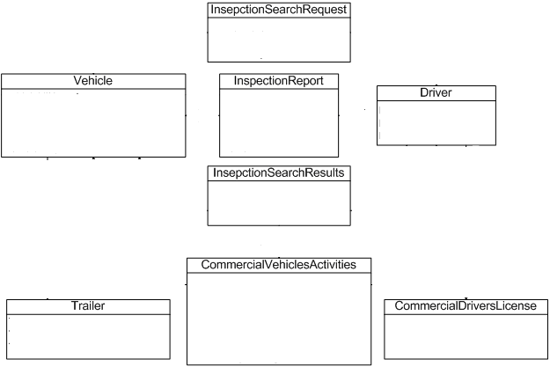
Building an exchange content model
Let us learn how to build a typical Exchange Content Model by developing one for a Customs Commercial Vehicle Tracker information exchange.
Read each step to learn more about developing an Exchange Content Model.
1
Identify Objects
Let us draw the objects which will be part of the Exchange Content Mode for the Customs Commercial Vehicle Tracker information exchange.
2
Draw Objects
3
Identify Elements
4
Draw Elements
5
Identify Associations
6
Draw Associations

Slide 57
Building an exchange content model
Let us learn how to build a typical Exchange Content Model by developing one for a Customs Commercial Vehicle Tracker information exchange.
Read each step to learn more about developing an Exchange Content Model.
1
Identify Objects
After identifying the objects, you can find out the elements for each of these objects for which these objects will be unique to each other. For example, the Driver object can have the following elements:
Driver First Name : string
Driver Surname : string
Driver DOB : date
Similarly, you need to identify the elements of each such objects.
2
Draw Objects
3
Identify Elements
4
Draw Elements
5
Identify Associations
6
Draw Associations

Slide 58
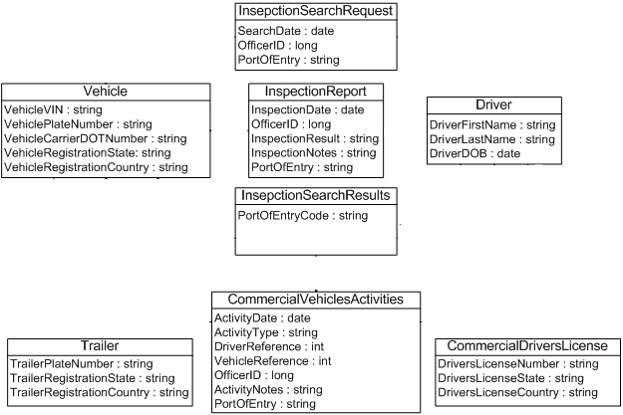
Building an exchange content model
Let us learn how to build a typical Exchange Content Model by developing one for a Customs Commercial Vehicle Tracker information exchange.
Read each step to learn more about developing an Exchange Content Model.
1
Identify Objects
After identifying the elements of each object, you need to draw them in the corresponding objects as shown below:
2
Draw Objects
3
Identify Elements
4
Draw Elements
5
Identify Associations
6
Draw Associations

Slide 59
Building an exchange content model
Let us learn how to build a typical Exchange Content Model by developing one for a Customs Commercial Vehicle Tracker information exchange.
Read each step to learn more about developing an Exchange Content Model.
1
Identify Objects
Now, you need to identify the type of association between the objects to best suit the need of the information exchange system. In this case, we find that all the objects are associated through inheritance. After finalizing the type of association between each object, you also need to find the cardinality of such association.
2
Draw Objects
3
Identify Elements
4
Draw Elements
5
Identify Associations
6
Draw Associations

Slide 60
Building an exchange content model
Let us learn how to build a typical Exchange Content Model by developing one for a Customs Commercial Vehicle Tracker information exchange.
Read each step to learn more about developing an Exchange Content Model.
1
Identify Objects
To complete building an Exchange Content Model, draw the association between the objects as shown below:
2
Draw Objects
3
Identify Elements
4
Draw Elements
5
Identify Associations
6
Draw Associations

Slide 61
Module 4: Knowledge check 1
Which of these steps are involved in preparing requirements for design process?
A. Analyze Requirements
B. Verify and Validate Requirements
C. Specify Exchange Requirements
D. A and B

Slide 62
Module 4: Knowledge check 2
The correct sequence of steps involved in building a typical Exchange Content Model are:
Organize the below steps in the correct order.
1
Draw Objects
2
Identify Elements
3
Identify Objects
Draw Associations
4
Identify Associations
5
Draw Elements
6

Slide 63
Next Steps: Mapping Document
After the you have created an Exchange Content Model, you can start to
associate local objects with types and elements in NIEM.
Exchange Content Model
Mapping Document
XML Schemas
Objects in the exchange content model are represented in the Mapping Document
Associations and cardinality may be represented in the Mapping Document
May utilize data objects not found in the NIEM data dictionary
Used in the process of mapping the elements of an information exchange to NIEM
Identifies data from the exchange content model that will reuse data objects in NIEM for the schemas in an IEPD
Content model data that does not map will be created in an extension
After completing a Mapping Document, elements and types can be identified for inclusion in NIEM subset schemas or extension schemas
If a “container” data object (complex XML element) in NIEM is reused, the object will not be able to hold character data

Slide 64
Summary
Welcome to Module 4: Map & Model
You should now be able to:
Build an exchange content model

Slide 65
Conclusion
Course Progress
80% complete

Slide 66
Learning recap
You have completed all the modules in NIEM 300: IEPD Discovery and Development course.
You should now be able to:
Perform the necessary research to begin to develop an IEPD
Develop a Use Case, Sequence Diagram, Business Process Diagram and an Exchange Content Model to define the business and technical structure of the information exchange
Define the Business Scenario, Rules, and Requirements necessary for IEPD development

Slide 67
Additional NIEm resources
Documentation
and Standards
For technical documentation:
NIEM.gov/reference
For all things NIEM:
NIEM.gov
DOCUMENTATION AND STANDARDS
Training
and Technical Assistance
For available resources that provide support and assistance:
NIEM Training: NIEM.gov/training NIEM Webinars: NIEM.gov/webinars NIEM Helpdesk: NIEM.gov/contactus
TRAINING & TECHNICAL ASSISTANCE
Available tools for developers: Visit the NIEM Tools Catalog today!
NIEM.gov/tools
For info on NIEM Engagement Process:
NIEM.gov/roadmaptoadoption
Tools
TOOLS

Slide 68
Next Steps…
Start your action plan and schedule your resources for NIEM training!
 | NIEM 100 | NIEM 101 | NIEM 200 | NIEM 300 | NIEM 301 | NIEM 302 | NIEM 303
Executive Managers
Program and Project Managers
Architects
Implementers
= Required
= Optional depending on role

Slide 69
End of course
Course Progress
100% complete

